Slide 1

Topic : New Cars in ackodrive website
Problem Statement : Price Analysis

Slide 2
ABOUT US :
NAMES:
Pavankalyan Thatipamula (MBA)
WHY DO WE WANT TO LEARN DATA SCIENCE ?
As Data Science is a board career path that is undergoing developments which promises abundant opportunities in the future.
EXPERIENCE :
Fresher

Slide 3
PROBLEM STATEMENT :
Buy a desirable New Car in affordable price.
Based on Price, Type, Model, Transmission, Engine and Fuel type we are going to recommend which model of new car is best.

Slide 4
PROCESS FOLLOWED :
Importing Libraries
Data Collection
Web Scrapping
Data cleaning
Data Analysis
Uni-variate Analysis
Bivariate Analysis
Multi-variate Analysis
Observation

Slide 5
LIBRARIES USED
1. Data Collection:
Requests, Beautiful soup, Pandas, NumPy, RE
2. Data Cleaning:
Pandas, RE(Regular Expressions)
3. Data Visualization:
Seaborn, Matplotlib

Slide 6

DATA COLLECTION:
Website :
Data Scraping link:
https://ackodrive.com/cars/page/1/

Slide 7
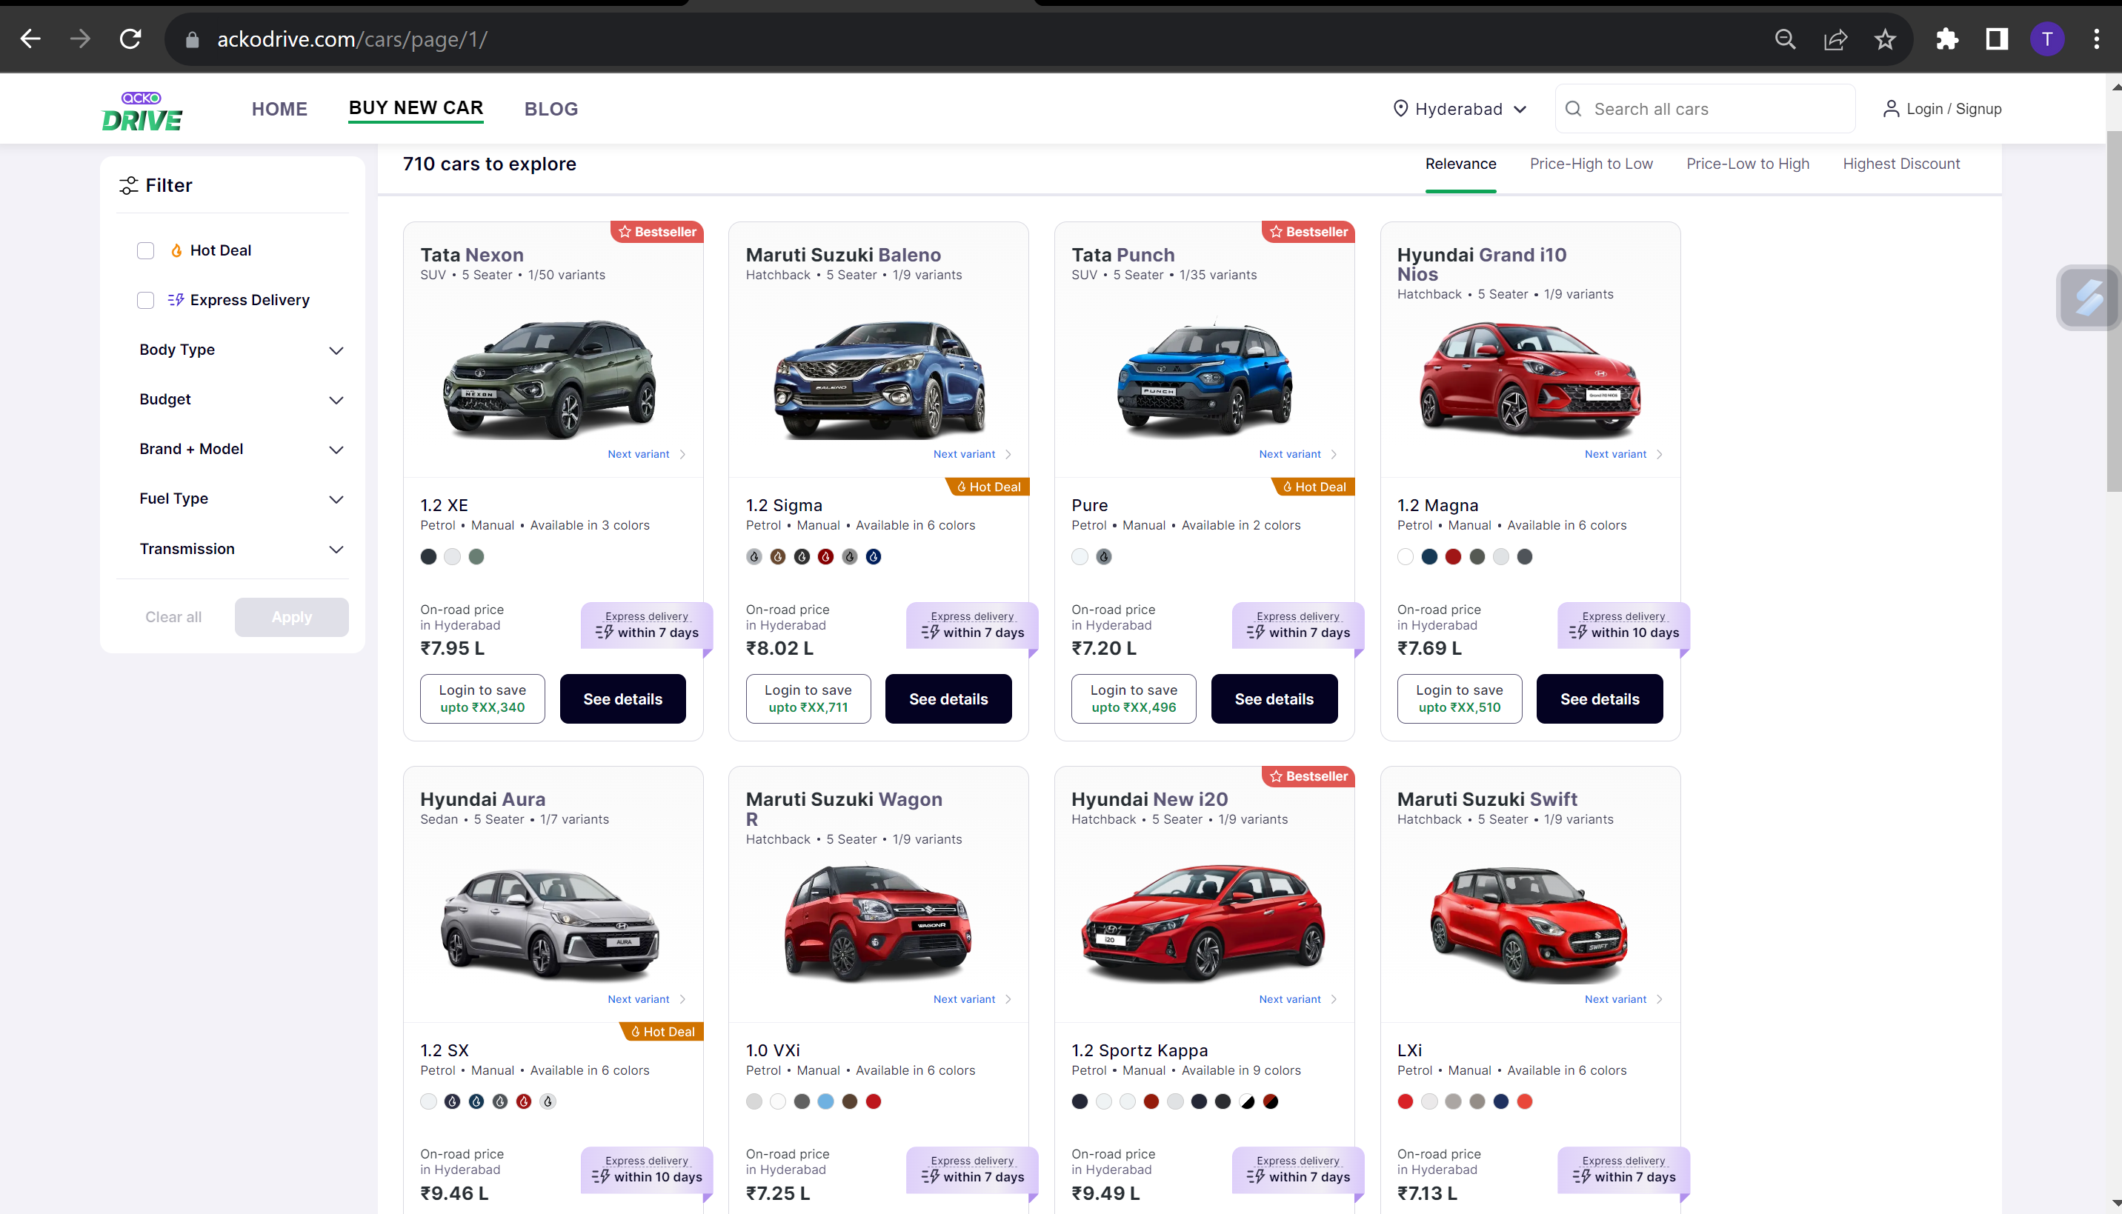
WEBSITE VEIW:

Slide 8
STEPS FOLLOWED TO COLLECT THE DATA:
Find the URL that you want to scrape.
Inspecting the Page.
Find the data you want to extract.
Write the code.
Run the code and extract the data.
Store the data in the required format.

Slide 9
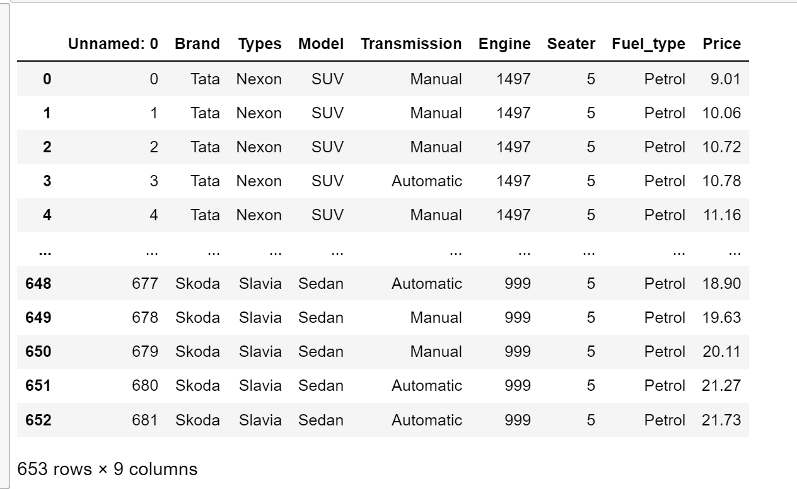
RAW DATA FRAME :

Slide 10
DATA CLEANING :
Identifying Null values.
Identifying Missing values.
Removing special symbols.
In place of null values, we imputed mean & median depending on the data.
Treating columns and converting required columns from object to int or float datatype.

Slide 11
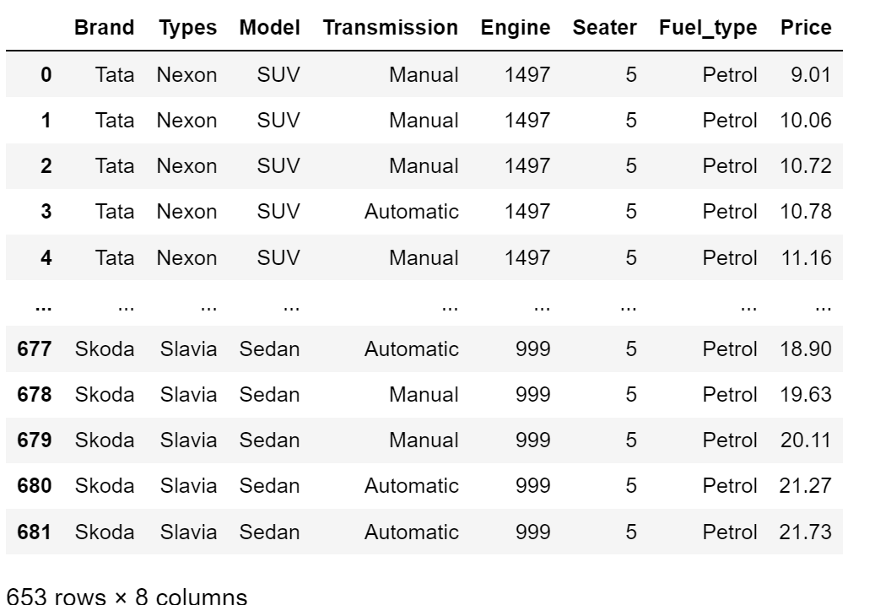
CLEANED DATA FRAME:

Slide 12
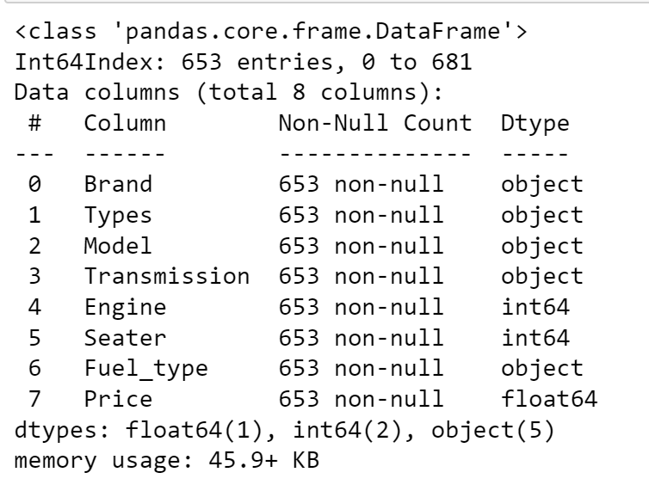
INFO, DUPLICATES, NULL VALUES :
We can now observe, that after performing data cleaning on data frame we have no null values in the data now.
The necessary columns’ conversion from object to int or object to float is likewise finished.

Slide 13
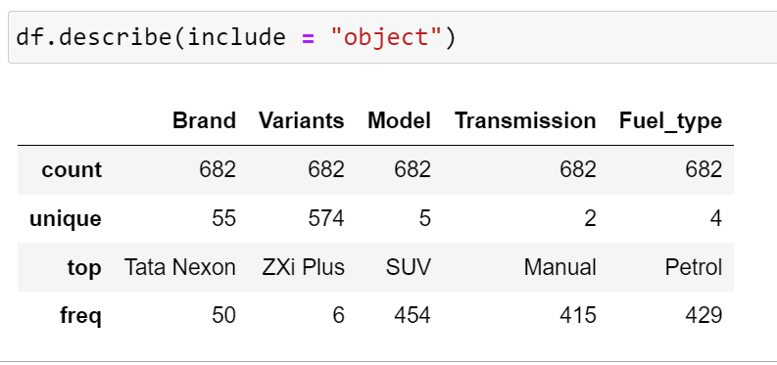
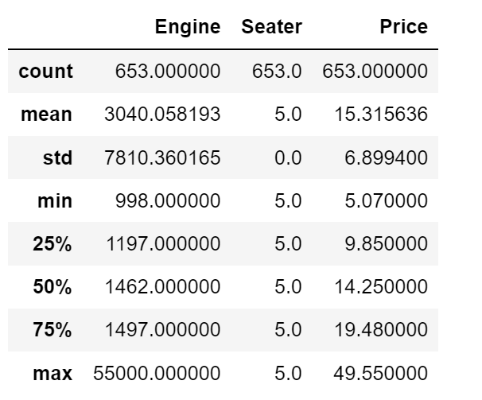
DESCRIBE :
By using, describe function we can know min, max, std percentile ranges of columns containing numerical data.

Slide 14
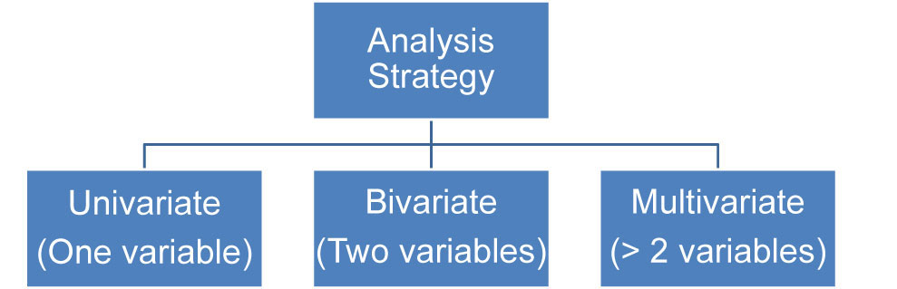
DATA VISUALIZATION :
1. UNI-VARIATE:
1.1 Single categorical
1.2 Single numerical
2. BI-VARIATE:
2.1 Categorical-Numerical
2.2 Numerical-Numerical
2.3 Categorical-Categorical
3. MULTI - VARIATE:
More than two columns we can take
3.1 Categorical-Numerical-Categorical
3.2 Categorical-Numerical-Numerical
3.3 Categorical-Categorical-Categorical
3.4 Numerical-Numerical-Numerical

Slide 15
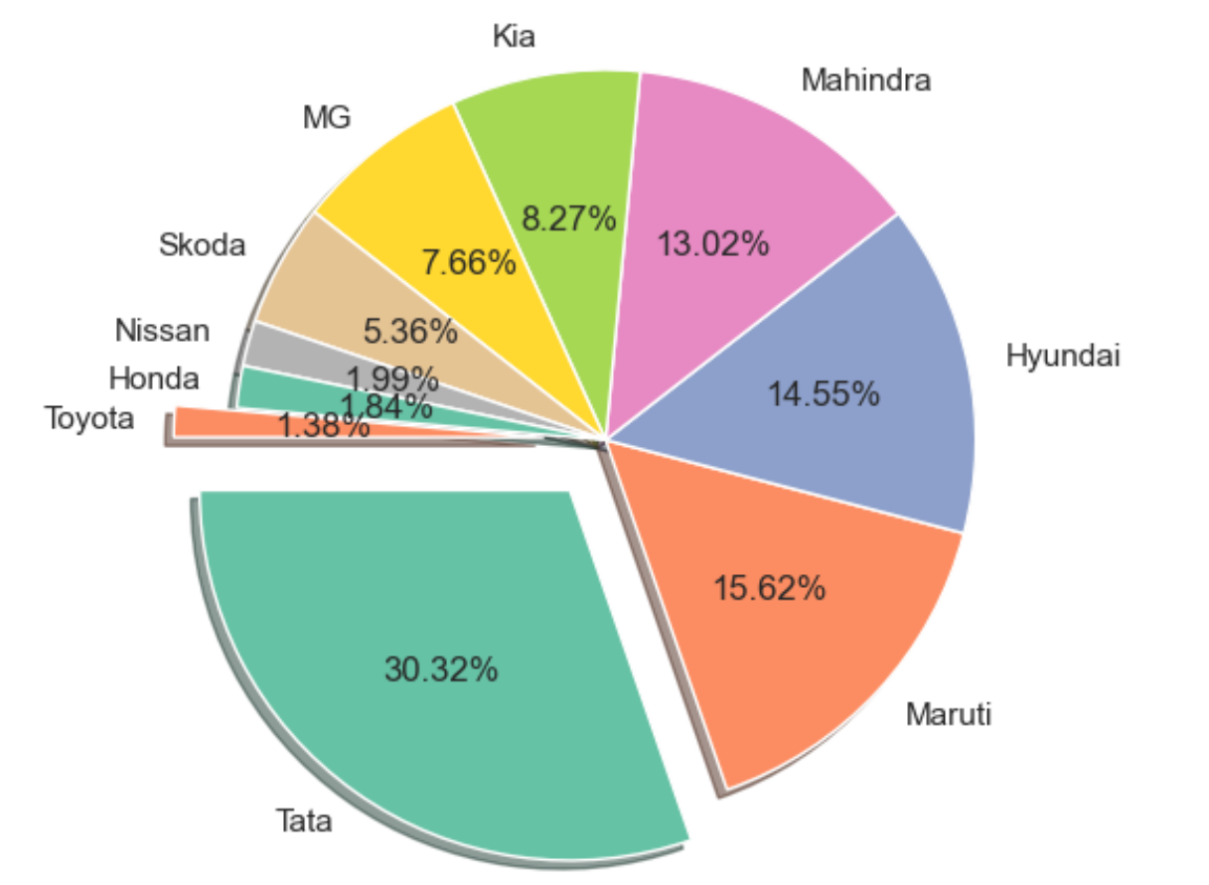
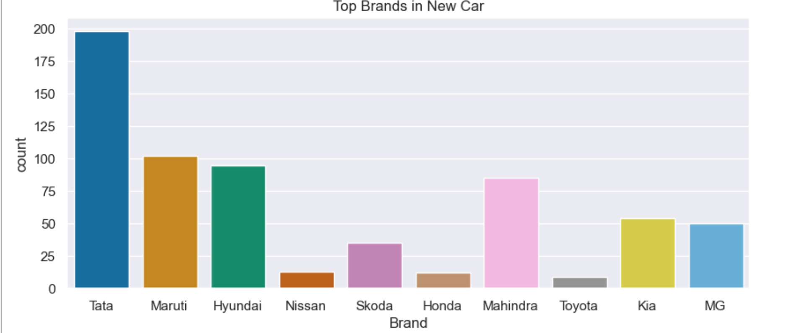
WHICH BRAND HAVE HIGH COUNT:
From the below count plot, we can observe the top 10 Brands of New cars.
Tata Brand has the highest count and occupied the first place. And it occupied the top most place and Maruti ranked second top Brand in our data in the market.

Slide 16
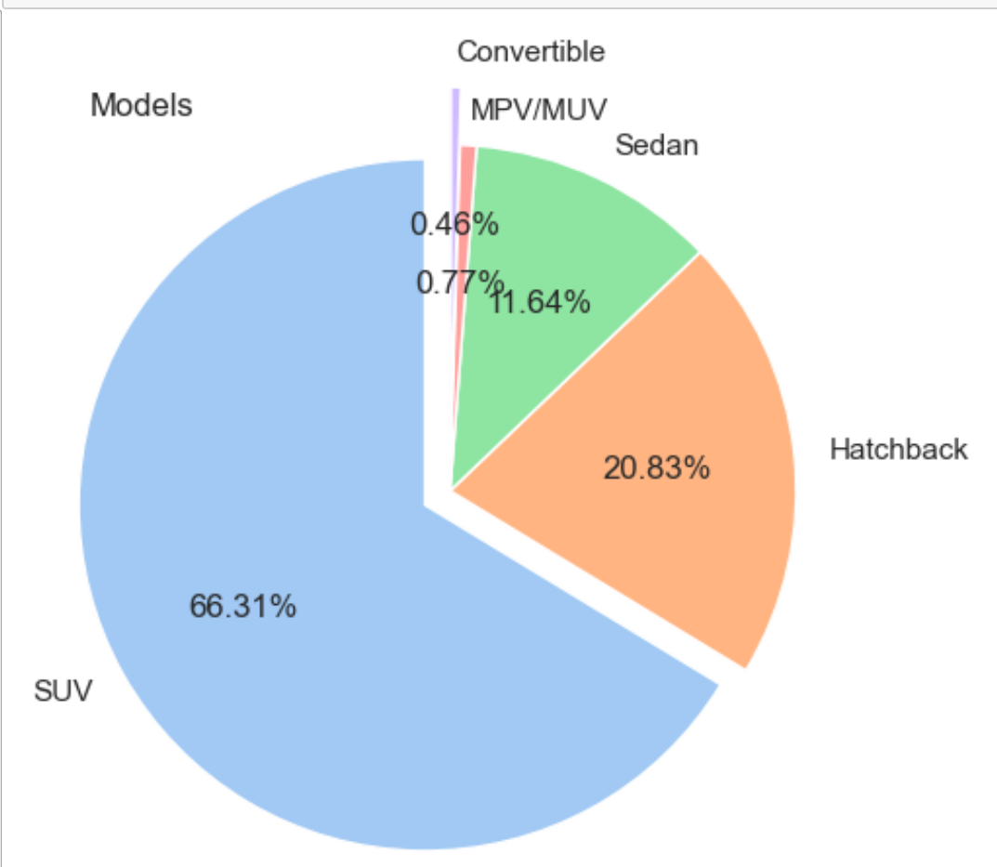
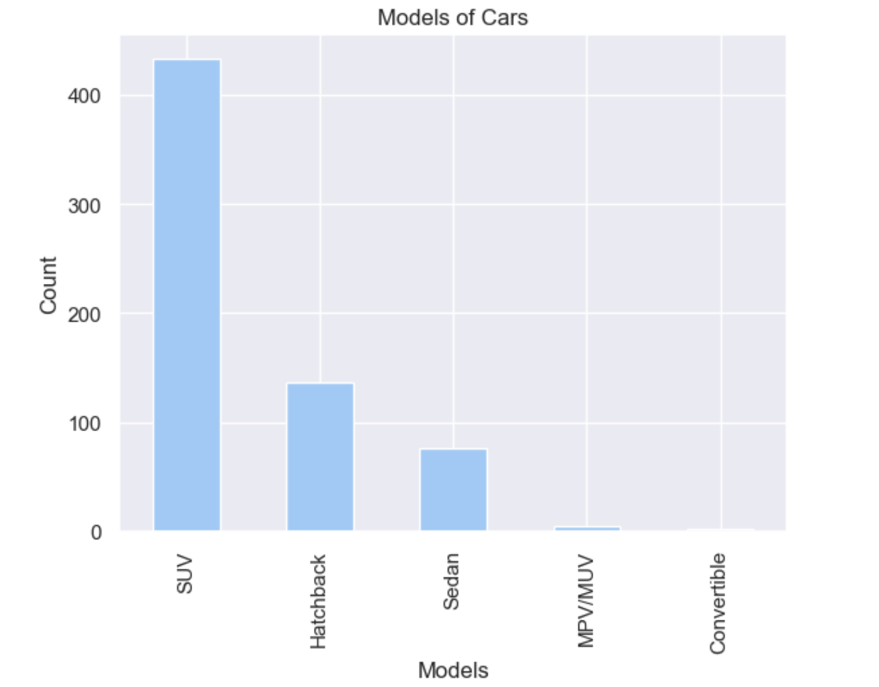
WHICH MODEL WAS HIGH:
SUV: The most common Models in the dataset is SUV with a count of 433. SUV stands for Sports Utility Vehicle, a car similar to a minivan or a station wagon, but with a much tougher look and a design suited for off-road driving.
Convertible ,MPV/MUV models have relatively lower counts in the dataset, with Convertible at 0.46%, MPV/MUV at 0.77%, These could be less commonly used models in New Cars.

Slide 17
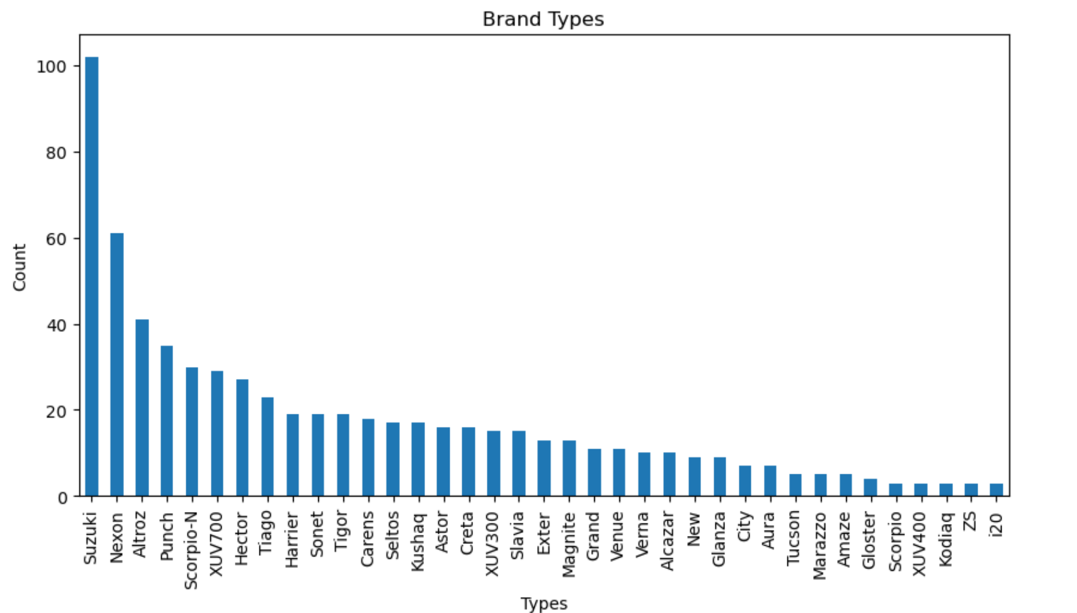
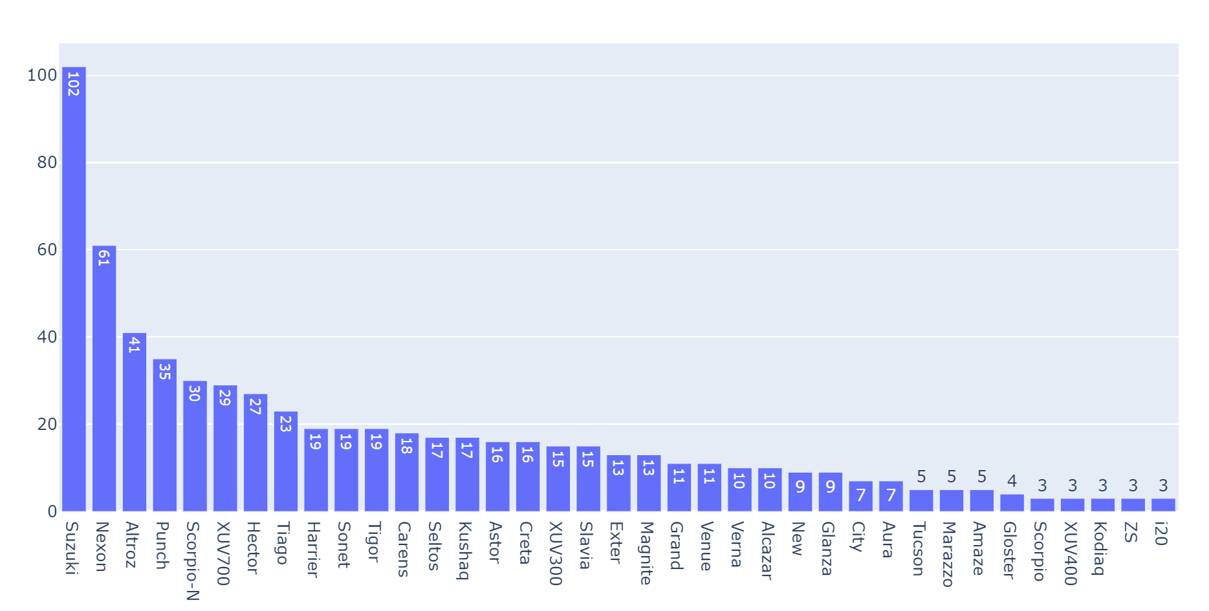
WHICH BRAND TYPE WAS HIGH :
Suzuki: The most common Brand Type in the dataset is Suzuki, with a count of 102.
i20,ZS,Kodiaq,XUV400,Scorpio are the lower Brand types in the Dataset with count of 3 .

Slide 18
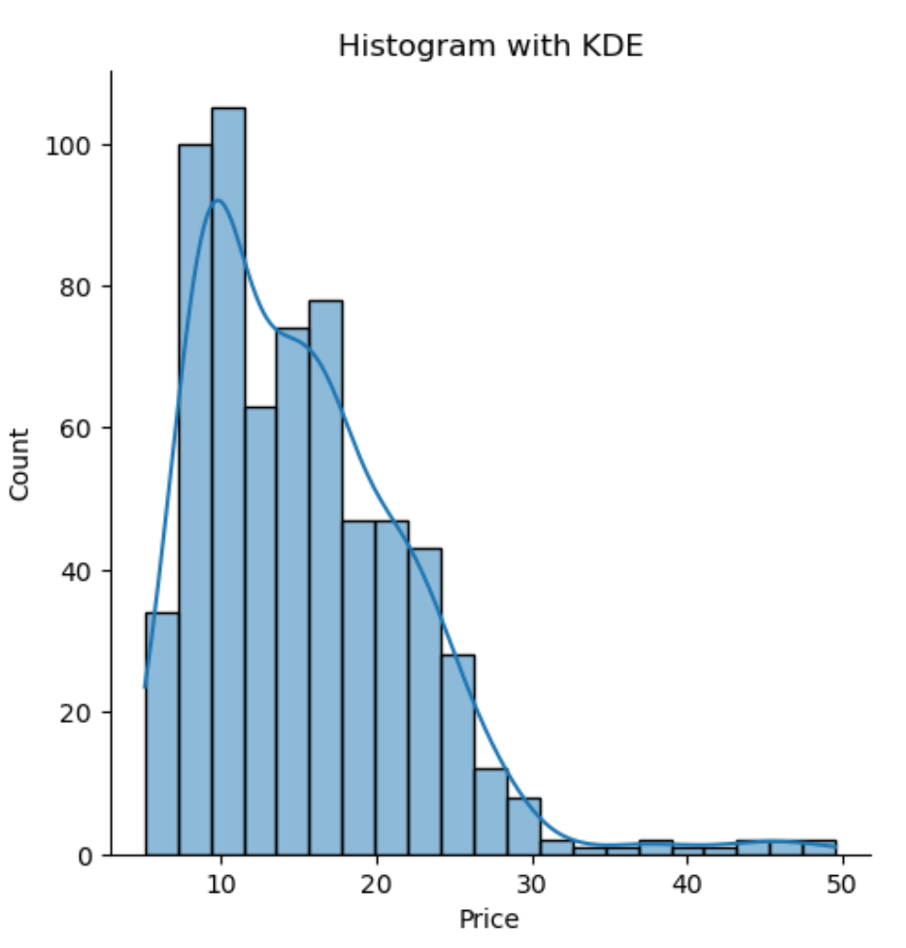
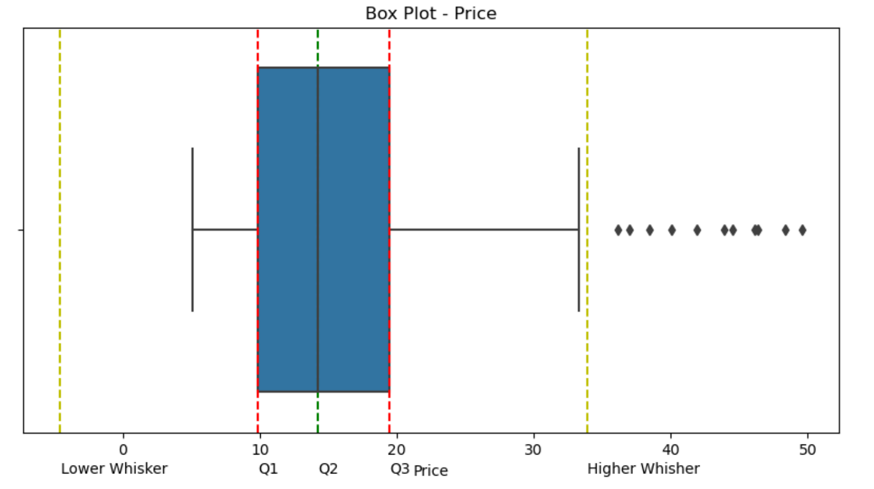
DENSITY OF PRICE (LAKHS) :
The above charts illustrate the density Cars available from price range of Rs.10L to 50L.
The Histogram with KDE plot describes that majority of Cars are under the price range of Rs.10L to 20 L.
Box plot identifies the decline in the density of TVs which fall under Rs.10L to 20L category.

Slide 19
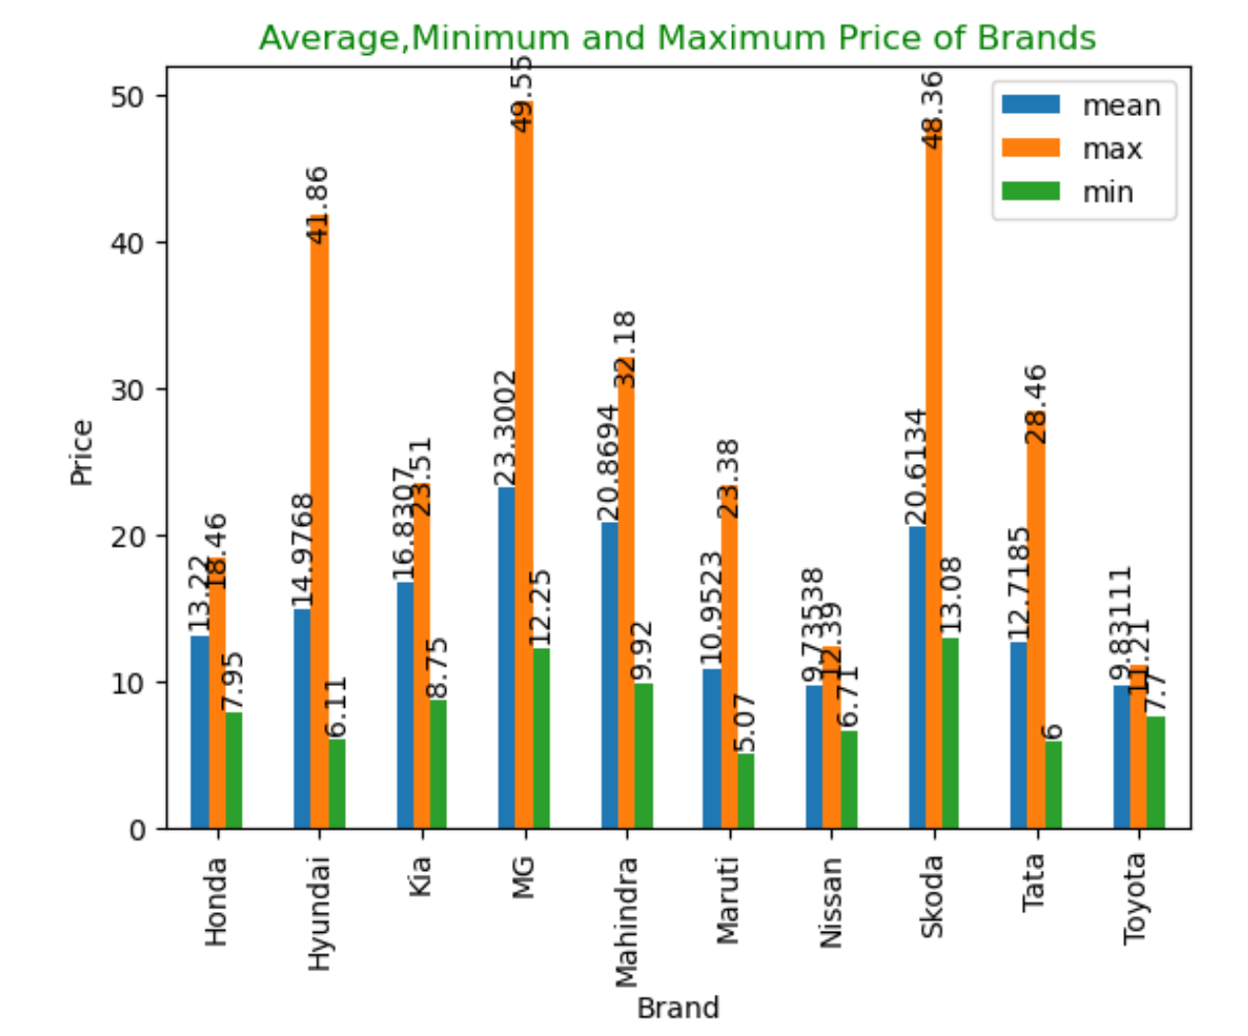
Brand wise Average, Minimum & Maximum Prices :
The Grouped-bar graph illustrates the Minimum, Maximum and Average Price’s
of different Car brands available on Acko-Drive.
From the graph , it can be seen that
MG Brand have maximum Price of 49,55 lakhs, Average Price of 23.3 lakhs and
Maruti Brand have lower price with minimum price of 5.07 lakhs.
.

Slide 20
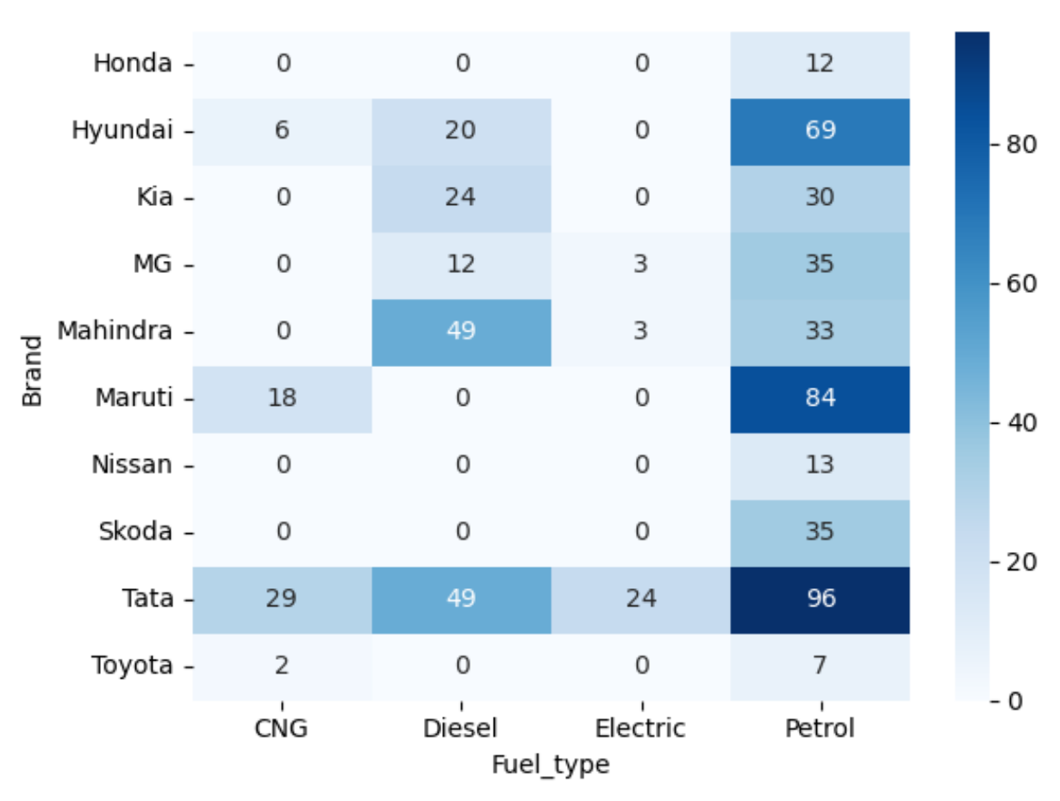
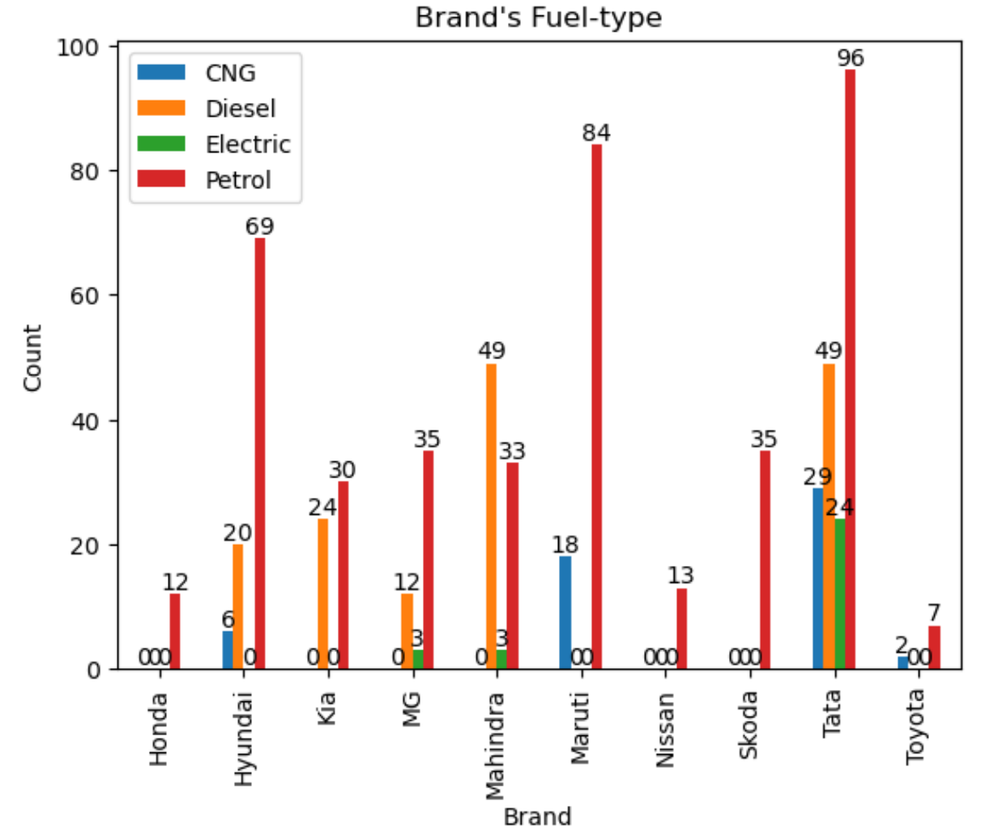
Fuel-types of Brands:
The above bar plot portrays the Fuel-types based on their brands.
From the above bar graph,
Tata Brand have all FUEL-TYPES i.e CNG,DIESEL,ELECTRIC,PETROL
Honda, Nissan & Skoda Brands have only one FUEL-TYPES i.e PETROL
From Heatmap and Grouped-bar plots :
Petrol Cars are most available cars in every Brand.
Diesel Cars second most available cars and next CNG and Electric cars.

Slide 21
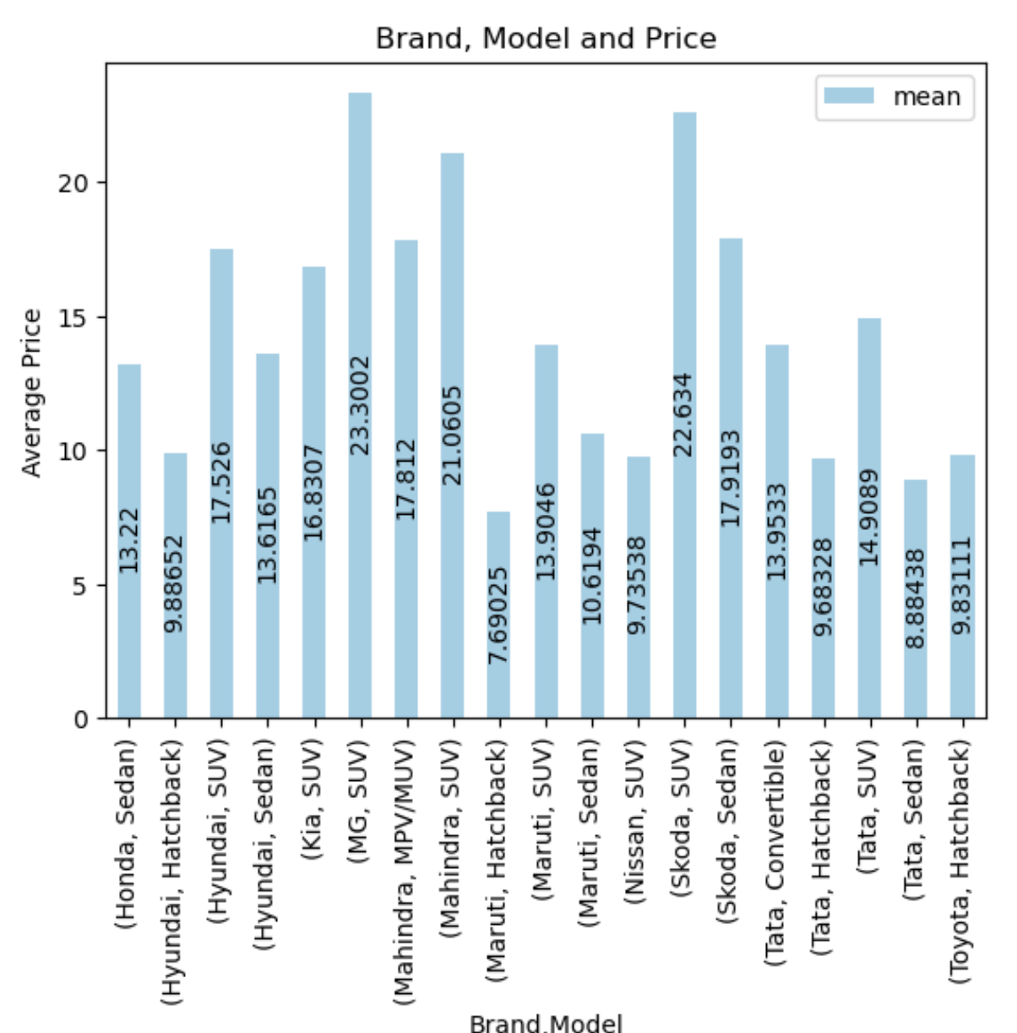
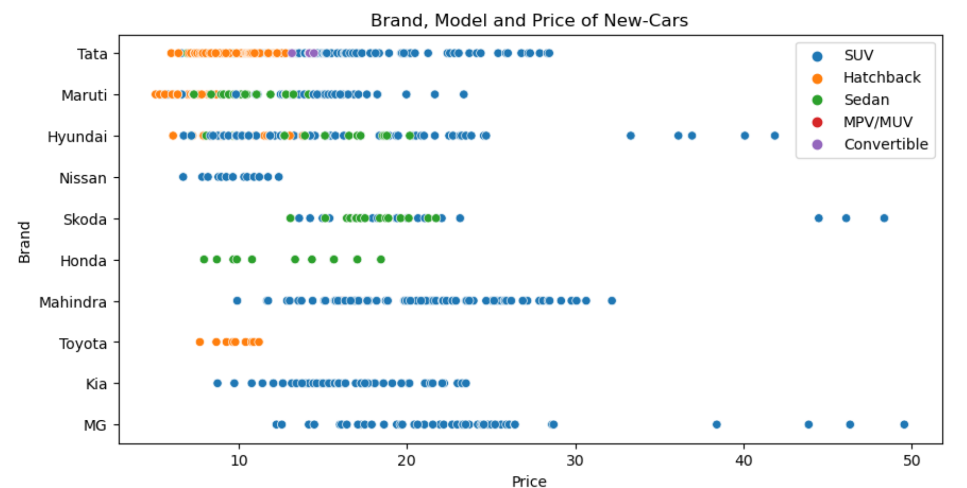
Brand, Model and Average Price :
From the bar plot portrays the Average Prices based on their brand and Models.
From the above bar graph,
MG SUV Model have high average Price, next Skoda SUV Model,Mahindra SUV Model.
Maruti Hatchback Model is lower Average Price compare to others
From Scatterplot and Grouped-bar plots :
SUV models have high average price in every Brand and Model..
Hatchback Model is lower Average price compare to other models.

Slide 22
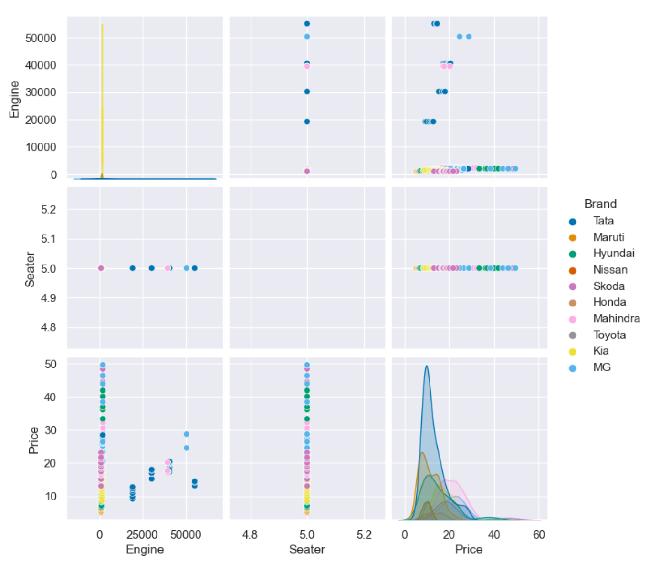
PAIR PLOT – BI VARIENT ANALYSIS :

Slide 23
From the EDA and Data Visualization the following conclusions can be drawn :
TATA Brand New Cars has the highest count in market.
SUV: The most common Models in the dataset is SUV with a count of 433. SUV stands for Sports Utility Vehicle, a car similar to a minivan or a station wagon, but with a much tougher look and a design suited for off-road driving.
SUZUKI: The most common Brand Type in the dataset is Suzuki, with a count of 102.
From the above data, it can be seen that Cars available from price range of Rs.10L to 50L.
Majority of Cars are under the price range of Rs.10 to 20 (Lakhs).
MG Brand have maximum Price of 49,55 lakhs, Average Price of 23.3 lakhs and TATA Brand have lower price with minimum price of 6 lakhs

Slide 24
TATA CARs has a variety of Fuel-type including low-priced to high priced touching the price of 6lakhs to 28.48 lakhs.
TATA Brand have all FUEL-TYPES i.e CNG,DIESEL,ELECTRIC,PETROL whereas, Honda, Nissan & Skoda Brands have only one FUEL-TYPES i.e PETROL
The more economical Cars brands being Tata, Nissan, Honda, Hyundai, Toyoto, Maruti and more.
SUV models have high average price in every Brand and Model. whereas, Hatchback Model is lower Average price compare to other models

Slide 25

Thank You

